Slide 1

DIVINE GRACE COLLEGE OF ARTS, SCIENCE AND TECHNOLOGY
(DGCAST) — GAROUA | GEOGRAPHY DEPARTMENT
UPPER SIXTH ARTS — POPULATION GEOGRAPHY — LESSON 11
The Modern Demographic Explosion and Population Policies
Mr KAMDEM EMMANUEL
Geography Teacher — PLEG
Academic Year 2026 / 2027
Notes:
Good morning, class. Today we study Lesson 11: The Modern Demographic Explosion and Population Policies.

Slide 2
GEOGRAPHY — UPPER SIXTH ARTS
CLASS INFO
Class, Chapter & Duration
Class | Upper Sixth Arts
Chapter | Module 4: Understanding and managing population dynamics across the world in general and Cameroon in particular
Duration | 2 periods (2 × 50 minutes)
2026 / 2027
DGCAST GAROUA — GEOGRAPHY DEPARTMENT
Mr KAMDEM E. | 2

Slide 3
GEOGRAPHY — UPPER SIXTH ARTS
IDENTIFICATION
Lesson Identification
Topic | Population Change over Time (Population Growth)
Sub-topic | Population Growth
Lesson | Lesson 11: The Modern Demographic Explosion and Population Policies
Notions / Concepts | Demographic explosion, anti-natal policy, pro-natal policy, one-child policy, migration law.
Syllabus focus | Causes and consequences of the demographic explosion; managing growth: pro-natal and anti-natal policies (China); migration laws (USA, Canada).
Competence | Learners are able to explain the demographic explosion and evaluate population policies.
2026 / 2027
DGCAST GAROUA — GEOGRAPHY DEPARTMENT
Mr KAMDEM E. | 3

Slide 4
GEOGRAPHY — UPPER SIXTH ARTS
OBJECTIVES
Learning Objectives
By the end of the lesson, the learner should be able to:
Explain the causes and consequences of the demographic explosion.
Describe anti-natal and pro-natal policies with examples.
Describe restrictive and open migration laws.
2026 / 2027
DGCAST GAROUA — GEOGRAPHY DEPARTMENT
Mr KAMDEM E. | 4

Slide 5
GEOGRAPHY — UPPER SIXTH ARTS
RECALL
Recall
World population grew very fast after 1950.
Education of women lowers birth rates.
2026 / 2027
DGCAST GAROUA — GEOGRAPHY DEPARTMENT
Mr KAMDEM E. | 5

Slide 6
GEOGRAPHY — UPPER SIXTH ARTS
REAL-LIFE SITUATION
Real-Life Situation
In 1979 China told most families to have only one child. Today it encourages families to have three. Meanwhile France pays families to have more children, and Canada invites skilled immigrants.
2026 / 2027
DGCAST GAROUA — GEOGRAPHY DEPARTMENT
Mr KAMDEM E. | 6
Notes:
Read the situation slowly, twice.

Slide 7
GEOGRAPHY — UPPER SIXTH ARTS
REAL-LIFE SITUATION
Situation — Question 1
What is the problem in the situation?
2026 / 2027
DGCAST GAROUA — GEOGRAPHY DEPARTMENT
Mr KAMDEM E. | 7

Slide 8
GEOGRAPHY — UPPER SIXTH ARTS
REAL-LIFE SITUATION
Answer
Governments try to control population in different ways.
2026 / 2027
DGCAST GAROUA — GEOGRAPHY DEPARTMENT
Mr KAMDEM E. | 8

Slide 9
GEOGRAPHY — UPPER SIXTH ARTS
REAL-LIFE SITUATION
Situation — Question 2
What was China's policy called?
2026 / 2027
DGCAST GAROUA — GEOGRAPHY DEPARTMENT
Mr KAMDEM E. | 9

Slide 10
GEOGRAPHY — UPPER SIXTH ARTS
REAL-LIFE SITUATION
Answer
The one-child policy (anti-natal).
2026 / 2027
DGCAST GAROUA — GEOGRAPHY DEPARTMENT
Mr KAMDEM E. | 10

Slide 11
GEOGRAPHY — UPPER SIXTH ARTS
REAL-LIFE SITUATION
Situation — Question 3
Why does France encourage births?
2026 / 2027
DGCAST GAROUA — GEOGRAPHY DEPARTMENT
Mr KAMDEM E. | 11

Slide 12
GEOGRAPHY — UPPER SIXTH ARTS
REAL-LIFE SITUATION
Possible Answer
Its population is ageing (pro-natal policy).
2026 / 2027
DGCAST GAROUA — GEOGRAPHY DEPARTMENT
Mr KAMDEM E. | 12

Slide 13
GEOGRAPHY — UPPER SIXTH ARTS
JUSTIFICATION
Justification of the Lesson
This lesson helps us to understand rapid population growth and how governments try to manage it.
2026 / 2027
DGCAST GAROUA — GEOGRAPHY DEPARTMENT
Mr KAMDEM E. | 13

Slide 14
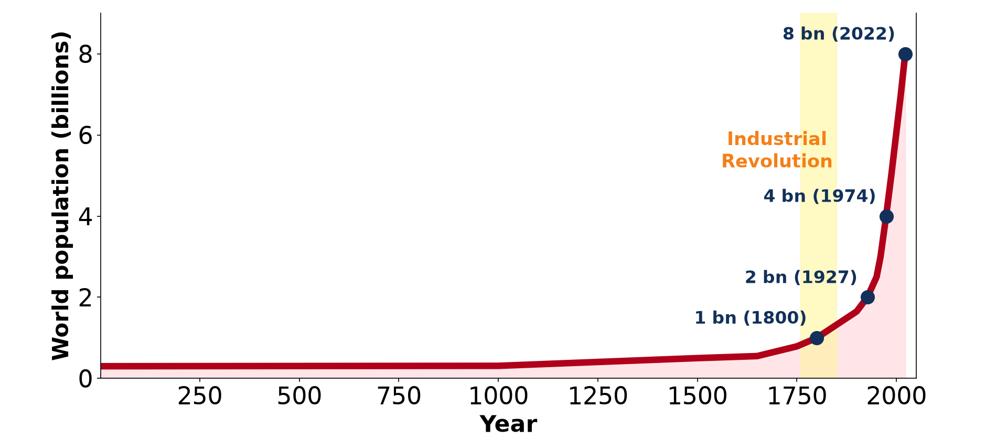
GEOGRAPHY — UPPER SIXTH ARTS
I. THE EXPLOSION
Activity 1
World population growth.
2026 / 2027
DGCAST GAROUA — GEOGRAPHY DEPARTMENT
Mr KAMDEM E. | 14
Notes:
Without the projector: point to the steep part of the curve.

Slide 15
GEOGRAPHY — UPPER SIXTH ARTS
I. THE EXPLOSION
Activity 1: Question
What caused the demographic explosion after 1950?
2026 / 2027
DGCAST GAROUA — GEOGRAPHY DEPARTMENT
Mr KAMDEM E. | 15

Slide 16
GEOGRAPHY — UPPER SIXTH ARTS
I. THE EXPLOSION
Answer
Death rates fell fast while birth rates stayed high.
2026 / 2027
DGCAST GAROUA — GEOGRAPHY DEPARTMENT
Mr KAMDEM E. | 16

Slide 17

GEOGRAPHY — UPPER SIXTH ARTS
II. CONSEQUENCES
Activity 2
A crowded market.
2026 / 2027
DGCAST GAROUA — GEOGRAPHY DEPARTMENT
Mr KAMDEM E. | 17
Notes:
Without the projector: list problems in big towns.

Slide 18
GEOGRAPHY — UPPER SIXTH ARTS
II. CONSEQUENCES
Activity 2: Question
Give two consequences of rapid population growth.
2026 / 2027
DGCAST GAROUA — GEOGRAPHY DEPARTMENT
Mr KAMDEM E. | 18

Slide 19
GEOGRAPHY — UPPER SIXTH ARTS
II. CONSEQUENCES
Answer
Unemployment and pressure on schools, housing and land.
2026 / 2027
DGCAST GAROUA — GEOGRAPHY DEPARTMENT
Mr KAMDEM E. | 19

Slide 20
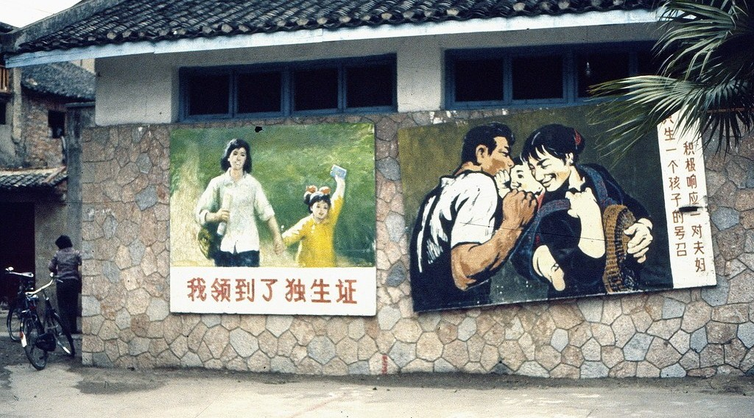
GEOGRAPHY — UPPER SIXTH ARTS
III. ANTI-NATAL POLICY
Activity 3
A poster for China's one-child policy.
2026 / 2027
DGCAST GAROUA — GEOGRAPHY DEPARTMENT
Mr KAMDEM E. | 20
Notes:
Without the projector: discuss the policy.

Slide 21
GEOGRAPHY — UPPER SIXTH ARTS
III. ANTI-NATAL POLICY
Activity 3: Question
Give one success and one problem of the one-child policy.
2026 / 2027
DGCAST GAROUA — GEOGRAPHY DEPARTMENT
Mr KAMDEM E. | 21

Slide 22
GEOGRAPHY — UPPER SIXTH ARTS
III. ANTI-NATAL POLICY
Answer
Success: slower growth. Problem: ageing and too many boys.
2026 / 2027
DGCAST GAROUA — GEOGRAPHY DEPARTMENT
Mr KAMDEM E. | 22

Slide 23
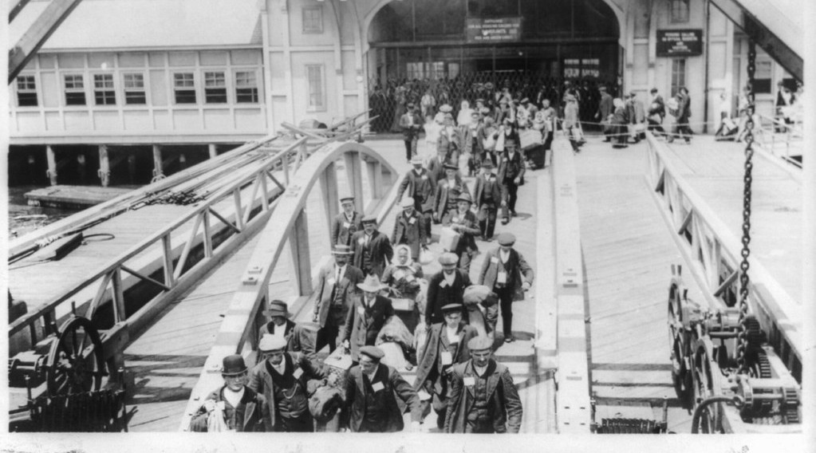
GEOGRAPHY — UPPER SIXTH ARTS
IV. MIGRATION LAWS
Activity 4
Immigrants at Ellis Island, New York (about 1909).
2026 / 2027
DGCAST GAROUA — GEOGRAPHY DEPARTMENT
Mr KAMDEM E. | 23
Notes:
Without the projector: find the USA and Canada on a map.

Slide 24
GEOGRAPHY — UPPER SIXTH ARTS
IV. MIGRATION LAWS
Activity 4: Question
How is Canada's migration policy different from the USA's?
2026 / 2027
DGCAST GAROUA — GEOGRAPHY DEPARTMENT
Mr KAMDEM E. | 24

Slide 25
GEOGRAPHY — UPPER SIXTH ARTS
IV. MIGRATION LAWS
Answer
Canada invites skilled workers with a points system; the USA uses quotas and border control.
2026 / 2027
DGCAST GAROUA — GEOGRAPHY DEPARTMENT
Mr KAMDEM E. | 25

Slide 26
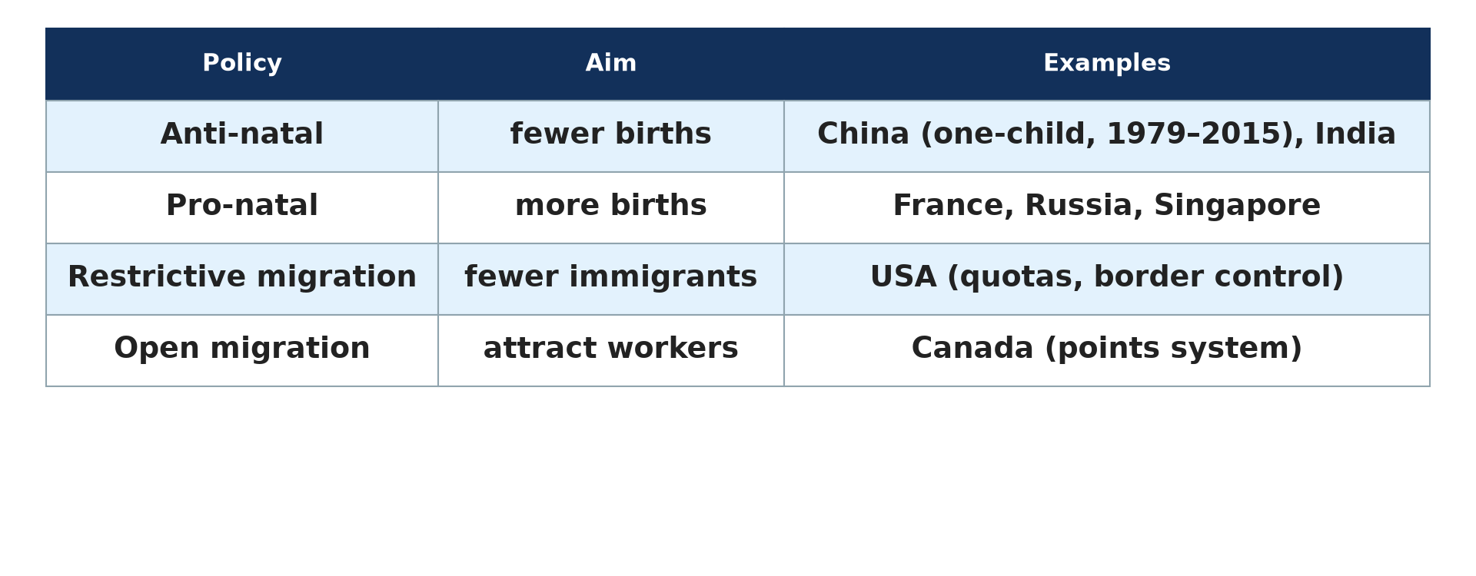
GEOGRAPHY — UPPER SIXTH ARTS
V. POLICIES
Activity 5
Types of population policy.
2026 / 2027
DGCAST GAROUA — GEOGRAPHY DEPARTMENT
Mr KAMDEM E. | 26
Notes:
Without the projector: copy the table.

Slide 27
GEOGRAPHY — UPPER SIXTH ARTS
V. POLICIES
Activity 5: Question
Why would a country adopt a pro-natal policy?
2026 / 2027
DGCAST GAROUA — GEOGRAPHY DEPARTMENT
Mr KAMDEM E. | 27

Slide 28
GEOGRAPHY — UPPER SIXTH ARTS
V. POLICIES
Answer
To stop an ageing and declining population.
2026 / 2027
DGCAST GAROUA — GEOGRAPHY DEPARTMENT
Mr KAMDEM E. | 28

Slide 29
GEOGRAPHY — UPPER SIXTH ARTS
BOARD SUMMARY
The Modern Demographic Explosion and Population Policies
Topic: Population Change over Time (Population Growth)
Sub-topic: Population Growth
Lesson 11: The Modern Demographic Explosion and Population Policies
2026 / 2027
DGCAST GAROUA — GEOGRAPHY DEPARTMENT
Mr KAMDEM E. | 29
Notes:
Learners copy the board summary now. Give them enough time for each slide.

Slide 30
GEOGRAPHY — UPPER SIXTH ARTS
BOARD SUMMARY
I. Definitions
Demographic explosion: It is a very rapid increase in population.
Anti-natal policy: It is a policy that tries to reduce births.
Pro-natal policy: It is a policy that tries to increase births.
2026 / 2027
DGCAST GAROUA — GEOGRAPHY DEPARTMENT
Mr KAMDEM E. | 30

Slide 31
GEOGRAPHY — UPPER SIXTH ARTS
BOARD SUMMARY
II. Causes and Consequences (1/2)
A. Causes: Medicine, vaccines and food cut death rates after 1950. Birth rates stayed high in LEDCs.
B. Consequences: Unemployment, slums, food shortages and pressure on the environment increased. Governments struggle to provide schools and health care.
2026 / 2027
DGCAST GAROUA — GEOGRAPHY DEPARTMENT
Mr KAMDEM E. | 31

Slide 32
GEOGRAPHY — UPPER SIXTH ARTS
BOARD SUMMARY
II. Causes and Consequences (2/2)
C. Opportunities: A young workforce can boost development. It needs education and jobs.
2026 / 2027
DGCAST GAROUA — GEOGRAPHY DEPARTMENT
Mr KAMDEM E. | 32

Slide 33
GEOGRAPHY — UPPER SIXTH ARTS
BOARD SUMMARY
III. Managing Growth (1/2)
A. Anti-natal (China): From 1979 to 2015 most families could have only one child. Growth slowed, but the population aged and there are more boys than girls.
B. Pro-natal: France and Russia give money, leave and services to families with children. Results are modest.
2026 / 2027
DGCAST GAROUA — GEOGRAPHY DEPARTMENT
Mr KAMDEM E. | 33

Slide 34
GEOGRAPHY — UPPER SIXTH ARTS
BOARD SUMMARY
III. Managing Growth (2/2)
C. Migration laws: The USA restricts immigration with quotas and border control. Canada attracts skilled migrants with a points system.
2026 / 2027
DGCAST GAROUA — GEOGRAPHY DEPARTMENT
Mr KAMDEM E. | 34

Slide 35
GEOGRAPHY — UPPER SIXTH ARTS
FORMATIVE EVALUATION
Formative Evaluation 1
What was the one-child policy? Give one consequence.
2026 / 2027
DGCAST GAROUA — GEOGRAPHY DEPARTMENT
Mr KAMDEM E. | 35

Slide 36
GEOGRAPHY — UPPER SIXTH ARTS
FORMATIVE EVALUATION
Expected Answer
A Chinese anti-natal policy (1979–2015); consequence: ageing and more boys than girls.
2026 / 2027
DGCAST GAROUA — GEOGRAPHY DEPARTMENT
Mr KAMDEM E. | 36

Slide 37
GEOGRAPHY — UPPER SIXTH ARTS
FORMATIVE EVALUATION
Formative Evaluation 2
Distinguish restrictive and open migration laws.
2026 / 2027
DGCAST GAROUA — GEOGRAPHY DEPARTMENT
Mr KAMDEM E. | 37

Slide 38
GEOGRAPHY — UPPER SIXTH ARTS
FORMATIVE EVALUATION
Expected Answer
Restrictive laws limit immigrants (USA); open laws attract them (Canada).
2026 / 2027
DGCAST GAROUA — GEOGRAPHY DEPARTMENT
Mr KAMDEM E. | 38

Slide 39
GEOGRAPHY — UPPER SIXTH ARTS
REMEDIATION
Remediation
Fill in the blanks:
A policy to reduce births is ______.
China's policy was the ______ policy.
Canada uses a ______ system for immigrants.
2026 / 2027
DGCAST GAROUA — GEOGRAPHY DEPARTMENT
Mr KAMDEM E. | 39
Notes:
Answers: 1. anti-natal 2. one-child 3. points

Slide 40
GEOGRAPHY — UPPER SIXTH ARTS
HOMEWORK
Homework
Should Cameroon adopt a population policy? Write a paragraph with two arguments.
This prepares Lesson 12: The Demographic Transition Model.
2026 / 2027
DGCAST GAROUA — GEOGRAPHY DEPARTMENT
Mr KAMDEM E. | 40
Notes:
This homework prepares the next lesson.

Slide 41
GEOGRAPHY — UPPER SIXTH ARTS
BILINGUAL GAME
Bilingual Game (Jeu Bilingue)
English | Français
Policy | La politique
Explosion | L'explosion
One-child policy | La politique de l'enfant unique
Quota | Le quota
Skilled worker | Le travailleur qualifié
Unemployment | Le chômage
2026 / 2027
DGCAST GAROUA — GEOGRAPHY DEPARTMENT
Mr KAMDEM E. | 41
Notes:
Say the English word; learners give the French word, then the reverse.

Slide 42
GEOGRAPHY — UPPER SIXTH ARTS
LOGBOOK
Official Logbook (1/2)
Module / Topic | Population Change over Time (Population Growth)
Lesson Title | Lesson 11: The Modern Demographic Explosion and Population Policies
Expected Learning Outcomes | Explain the causes and consequences of the demographic explosion. Describe anti-natal and pro-natal policies with examples. Describe restrictive and open migration laws.
Competence | Learners are able to explain the demographic explosion and evaluate population policies.
2026 / 2027
DGCAST GAROUA — GEOGRAPHY DEPARTMENT
Mr KAMDEM E. | 42

Slide 43
GEOGRAPHY — UPPER SIXTH ARTS
LOGBOOK
Official Logbook (2/2)
Matter Taught | I. Definitions: Demographic explosion, Anti-natal policy, Pro-natal policy; II. Causes and Consequences: Causes, Consequences, Opportunities; III. Managing Growth: Anti-natal (China), Pro-natal, Migration laws.
Evaluation | Formative evaluation (3 questions) and remediation exercise.
Homework | Should Cameroon adopt a population policy? Write a paragraph with two arguments.
Enrolment / Present / Absent | ____ / ____ / ____
Achievement | To be completed by the teacher after the lesson.
2026 / 2027
DGCAST GAROUA — GEOGRAPHY DEPARTMENT
Mr KAMDEM E. | 43

Slide 44
GEOGRAPHY — UPPER SIXTH ARTS
TEACHER'S NOTE
Teacher's Note
Timing: Set-up, recall 8 min | Situation 8 min | 5 activities 30 min | Board summary (copying) 30 min | Evaluation, remediation 10 min | Homework, logbook 9 min | Spare 5 min
2026 / 2027
DGCAST GAROUA — GEOGRAPHY DEPARTMENT
Mr KAMDEM E. | 44

Slide 45
GEOGRAPHY — UPPER SIXTH ARTS
REFERENCES
References
National Geography Syllabus, Sixth Forms (Lower & Upper Sixth), MINESEC/IGE/IP-SS, August 2019 — Module 4 (Population Geography).
Photo, Activity 2: “Wax market” by zouzouwizman, CC BY 2.0, via Flickr (https://www.flickr.com/photos/61111202@N00/12129001)
Photo, Activity 3: “propaganda posters, one child policy” by kattebelletje, CC BY-NC 2.0, via Flickr (https://www.flickr.com/photos/97249369@N00/3349125321)
Photo, Activity 4: “No Known Restrictions: Ellis Island Immigrants by National Photo Co., ” by pingnews.com, Public domain 1.0, via Flickr (https://www.flickr.com/photos/39735679@N00/434439223)
Diagrams and animations: drawn for this lesson (DGCAST Geography Department).
2026 / 2027
DGCAST GAROUA — GEOGRAPHY DEPARTMENT
Mr KAMDEM E. | 45

